Slide 1
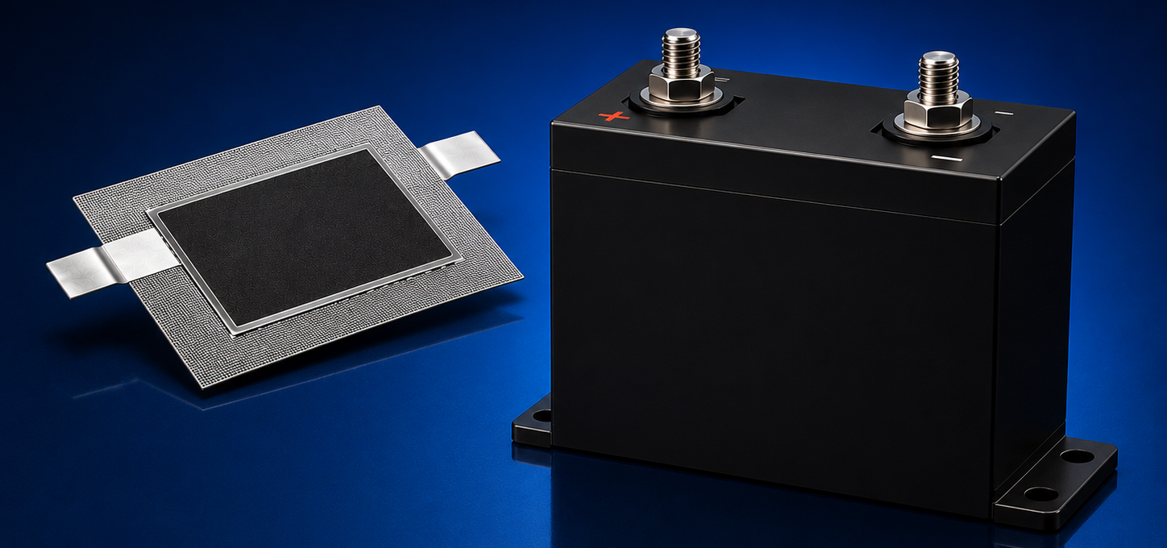
CSIC/AF/027
Hybrid supercapacitor with high energy density
The transition to renewable energy and the electrification is increasing demand for energy storage systems that combine high power with high energy density. Lithium-ion batteries offer high energy density, but charge and discharge slowly and depend on critical raw materials. Conventional supercapacitors charge and discharge rapidly at high power, but their low energy density and high fabrication cost limit their use in energy-intensive applications.
There is a clear market need for a high energy density supercapacitor, based on abundant raw materials, for applications such as grid stabilization, rail transport, EV fast charging, industrial equipment starting and electric aviation.
A new asymmetric supercapacitor with increased energy density while preserves high power and long cycle life.
The electrodes combine porous carbon matrices with metal oxides, thus having high surface-to-volume ratios and redox reactions (hybrid electrodes). The final step of electrodes fabrication is a pulsed laser processing. Aqueous and organic electrolytes can be used.
Asymmetric supercapacitor device with high energy density and high power.
Priority patent application filed
Higher energy density than conventional supercapacitors while maintaining high power.
Fabricated from abundant, non-critical raw materials.
Up to 50% lower fabrication cost per Wh.
Up to 50% lower production energy per Wh.
Compatible with safer aqueous electrolytes.
Long cycle life validated in laboratory prototypes (>30,000 cycles).
Prototype validated in laboratory
Alfonso del Rey
adelrey@icmab.es

